Slide 1
NLP
Natural language processing and web scraping
Xu Huang, Runzhou Liu, Jiayue Meng, Yixu Qiu, Yumeng He, Peirong Hao, Bowen Jin

Slide 2
Methods
SVM
Text Classification

Slide 3
SVM - Dataset
Collected faculty webpages by ourselves from different universities
- UR, UB, Vanderbilt, Stanford, UCLA
Faculty are from different majors
- history, physics, computer science, and etc.
Self-designed function for collecting and choosing meaningful words

Slide 4
SVM – Data Collection
Use web crawler to get URL of all faculty websites.
Take and count only nouns for each websites.
- nouns are unique and objective
- appropriate nouns
- Website Format Issue
Number of keywords to be determined

Slide 5
SVM - Model
After comparing numerous kernel functions including ‘linear’, ‘rbf’, ‘gaussian’ etc. Considering accuracy and speed, the kernel function we choose is ’rbf’.
For the number of C, we pick 100.
An average accuracy for 100 tests would be shown as the result.

Slide 6
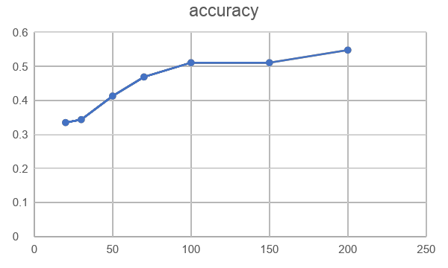
SVM – Result (24 departments)
Include data from 24 departments
Totally 622 data points.
num_words | accuracy
20 | 0.335
30 | 0.3437
50 | 0.413
70 | 0.469
100 | 0.511
150 | 0.511
200 | 0.548

Slide 7
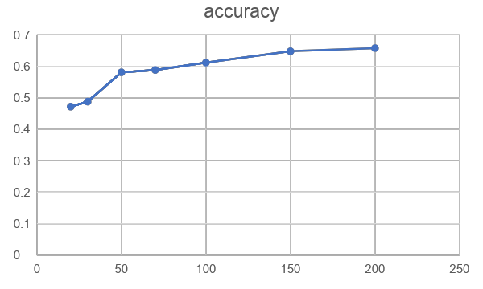
SVM – Result (13 departments)
Include data from 13 departments, delete departments with too little data among 24 departments
Totally 477 data points.
num_words | accuracy
20 | 0.472
30 | 0.488
50 | 0.581
70 | 0.5885
100 | 0.612
150 | 0.648
200 | 0.658

Slide 8
Limitation:
time-consuming to get enough data
not accurate for too many departments
hard to test a single webpage

Slide 9
Idea for Improvement
Collect more data
Try new method
(1)LDA
(2)Text-Classification
Notes:
Considering that even if we use a better crawler method, because the number of professors in some departments is only a few, we can't get enough data, so we decided to try to use news as a new dataset

Slide 10
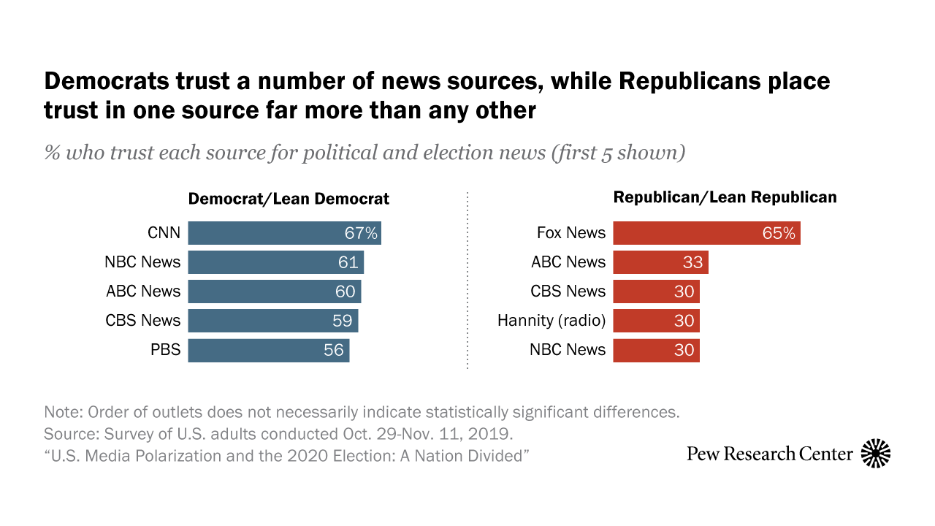
Dataset - Newspaper
7 Newspapers: CNN, NBC, CBS, PBS, FOX, ABC, BBC
Web crawler (newspaper3k)
Url, category, source, title, text, summary, keywords
Notes:
Partisanship in Americans’ main sources for political news, did some research and chose famous newspapers that both democrats and republicans trust as our data sources
store them in csv files

Slide 11
Data Preprocessing
Filtered news in other languages (Spanish, Arabic, etc.)
Removed videos from data
Removed N/A values
Replaced names and iconic slogans of newspapers with space in their news
- "(CNN)", "Fox", "abc"
- "NEW You can now listen to Fox News articles!"
Notes:
prevent the model to classify the source using the name of newspapers

Slide 12
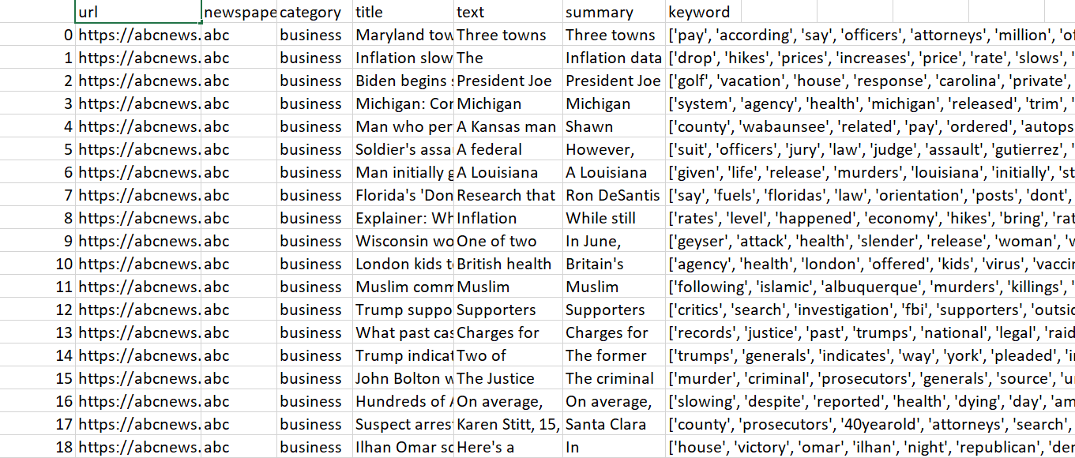

Slide 13
LDA
Unsupervised
Words order do not matter

Slide 14
Text-Classification
Using model in spacy library to dealing with dataset with different linguistic features, training data and output analysis result.
Notes:
In our case, we would choose “Textcat” under components, CPU-preferred in hardware, and “Optimize-for”: efficiency. Usually SpaCy will provide sane defaults for each parameter. They won't be the best parameters for your problem, but they will work just fine for most data.

Slide 15
Linguistic Features
1. Sentence detection
2. Tokenization
3. Stop words
Notes:
1, In the model, a period is used as the criterion for judging the end of sentence.
2, Breaking down paragraphs into sentenses and then sentenses into words, punctuations and so on. we will load english language model to tokenize our english text.Every language is different and have different rules. Spacy offers 8 different language models.
3, We used the stopword provided by the space library. At the beginning, we were worried that our company's name would be mentioned in the news of different news companies. However, we selected several articles as sample tests. In addition, we had preprocessed the data set when we obtained it, so we did not adjust stopwords in the end.

Slide 16
Training
Tok2vec: Apply a “token-to-vector” model and set its outputs in the Doc.tensor attribute.
Docbin: Serialize the information from a collections of Doc objects. The process can be controlled by passing a list of attribute IDs and specifying whether the user data is serialized.
Notes:
Training in Spacy uses the tok2vec layer. It uses the length of words and other features to dynamically generate vectors. The advantage is that it can handle previously unseen words and provide them with numerical representation. The disadvantage is that its embedding does not represent its meaning.
The pre training word vector is a digital representation of each tag derived from a large number of texts, and attempts to embed the meaning of the word into the high-dimensional space. This helps to group semantically similar words together.

Slide 17
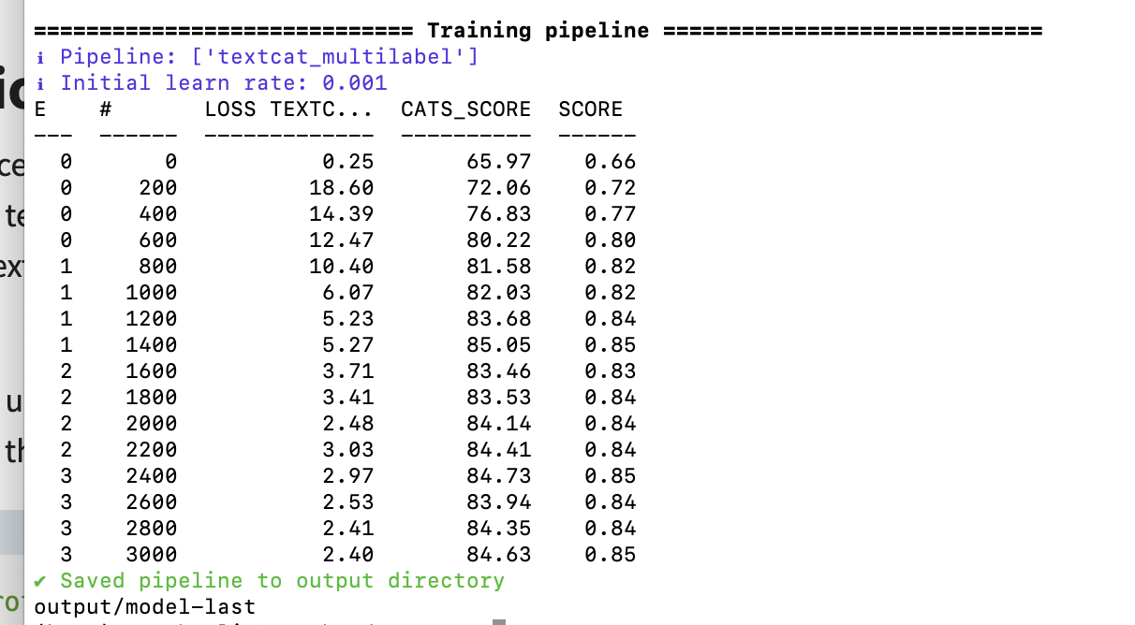
For each training step, it will yield an output with its loss and accuracy. The loss tells us how big the mistakes of the classifier are and the score tells us how often the text-classification is correct.

Slide 18
Future Plan
Still a lot questions need to be answered:
have the newspaper companies changed in past years? (add time dimension)
Is there better method?

Slide 19
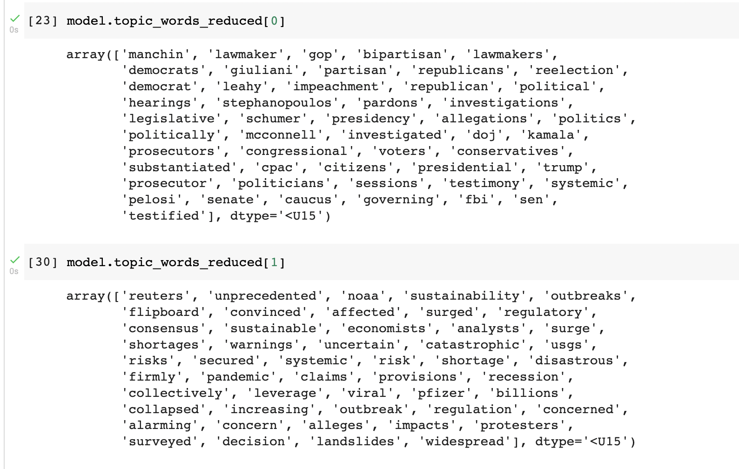
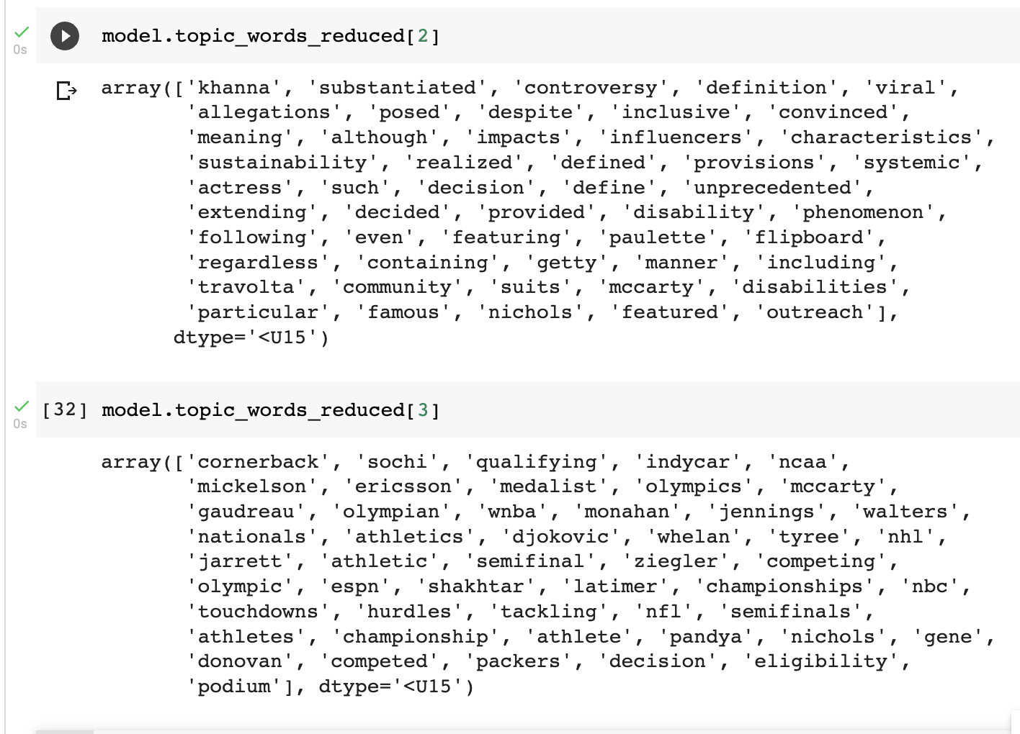
Category Classification
4 Categories: Business, Politics, Tech, and Sports
Top2Vec: an algorithm for topic modeling and semantic search
Notes:
It automatically detects topics present in text and generates jointly embedded topic, document and word vectors.
an unsupervised method
told the model we have 4 categories

Slide 20
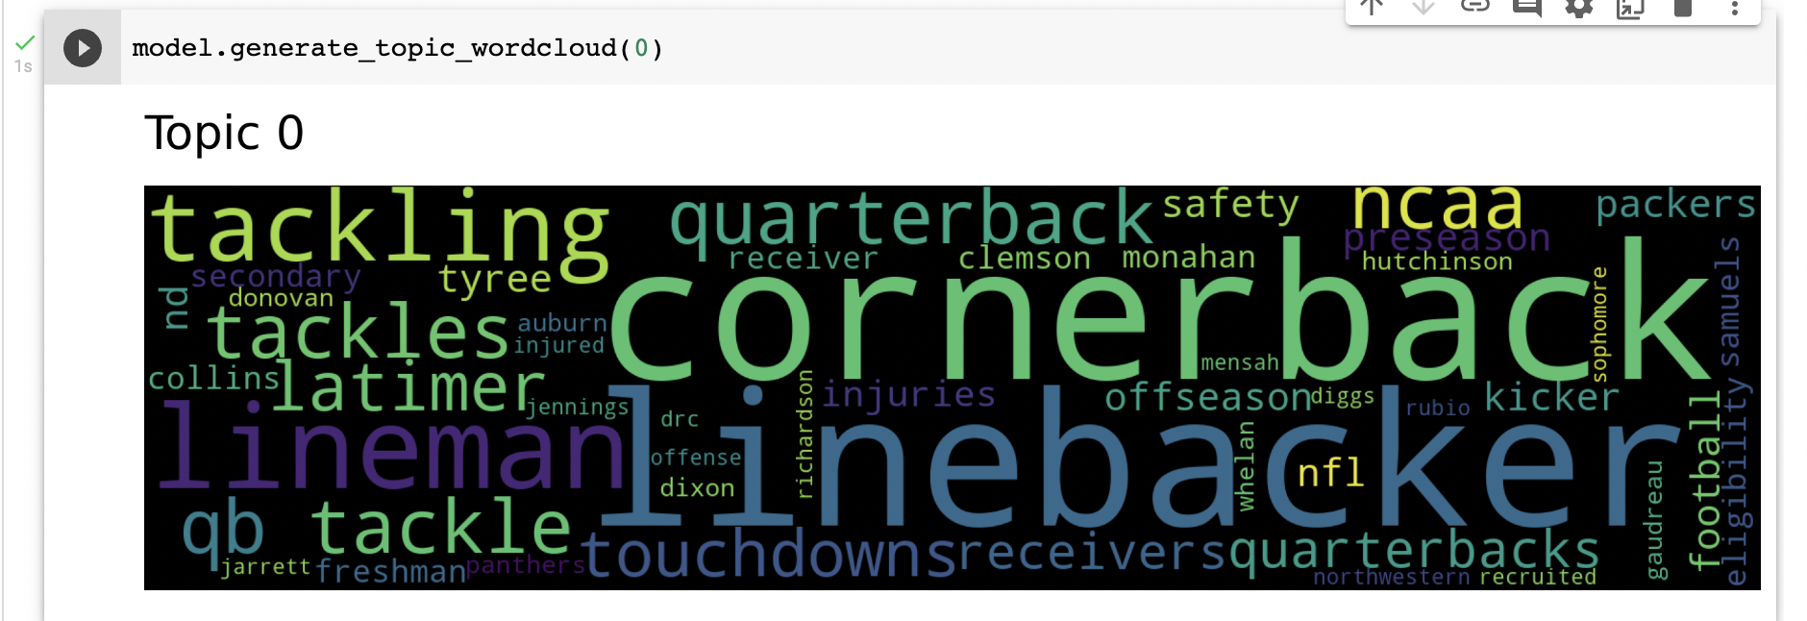


Slide 21
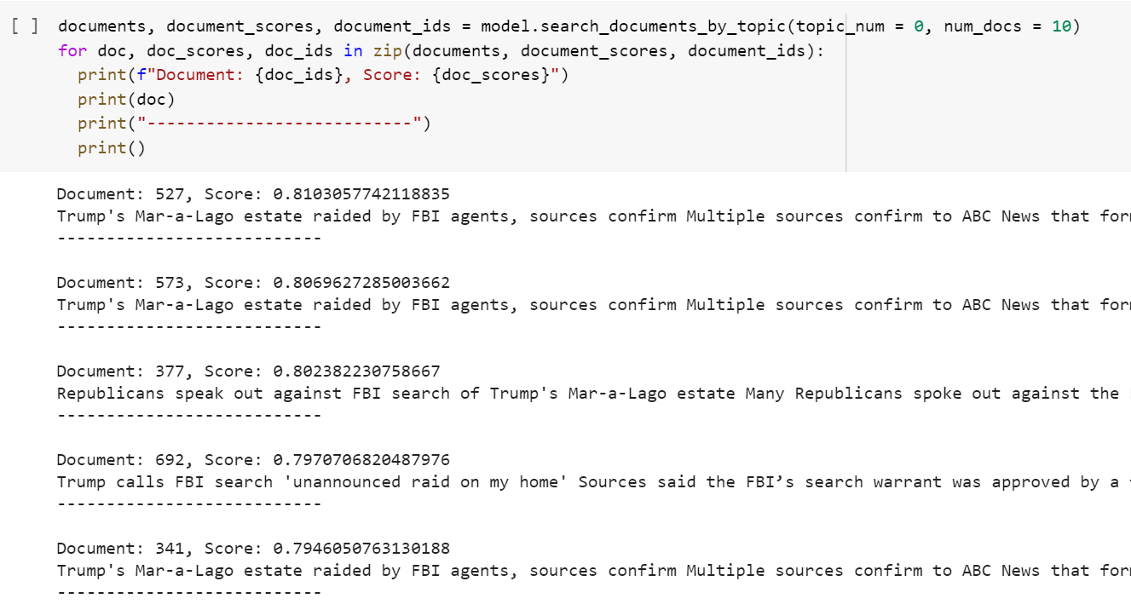
Notes:
the model already classified the our data into 4 categories
if we search for the top 10 articles in the first topic, we can print out document ids, scores, and texts

Slide 22
Future Plan
Match the 4 topics generated by the model with the 4 categories of newspaper
Test the model with new data for improvement

Slide 23
Reference
https://www.pewresearch.org/fact-tank/2020/04/01/americans-main-sources-for-political-news-vary-by-party-and-age/
https://www.pewresearch.org/journalism/2020/01/24/democrats-report-much-higher-levels-of-trust-in-a-number-of-news-sources-than-republicans/
https://spacy.io/api/docbin

